Slide 1
Empathetic Dialogue Generation
Pingsheng Liu
2021.12.13

Slide 2

Outlines
Dataset
2019 ACL Towards Empathetic Open-domain Conversation Models: a New Benchmark and Dataset
2020 EMNLP Towards Persona-Based Empathetic Conversational Models
2021 ACL Findings CoMAE: A Multi-factor Hierarchical Framework for Empathetic Response Generation
Model
2020 AAAI EmpTransfo: A Multi-Head Transformer Architecture for Creating Empathetic Dialog System
2019 EMNLP MoEL: Mixture of Empathetic Listeners
2020 EMNLP MIME: MIMicking Emotions for Empathetic Response Generation
2021 CIKM Exemplars-guided Empathetic Response Generation Controlled by the Elements of Human Communication

Slide 3
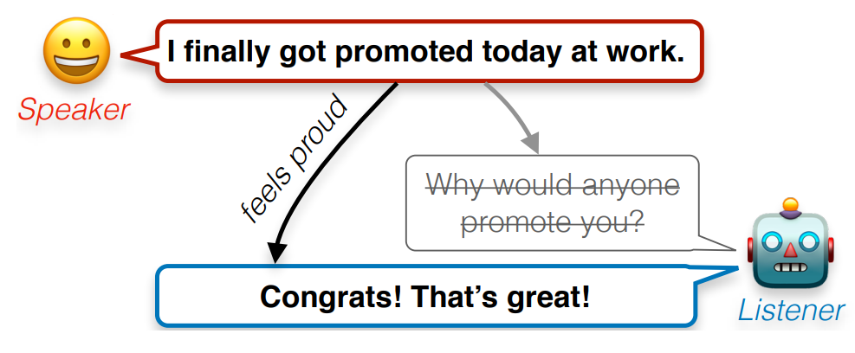
Empathetic responding
Conversation partner
describe personal experiences
response
Dialogue agent
understand and acknowledge any implied feelings
2019 ACL Towards Empathetic Open-domain Conversation Models: a New Benchmark and Dataset

Slide 4
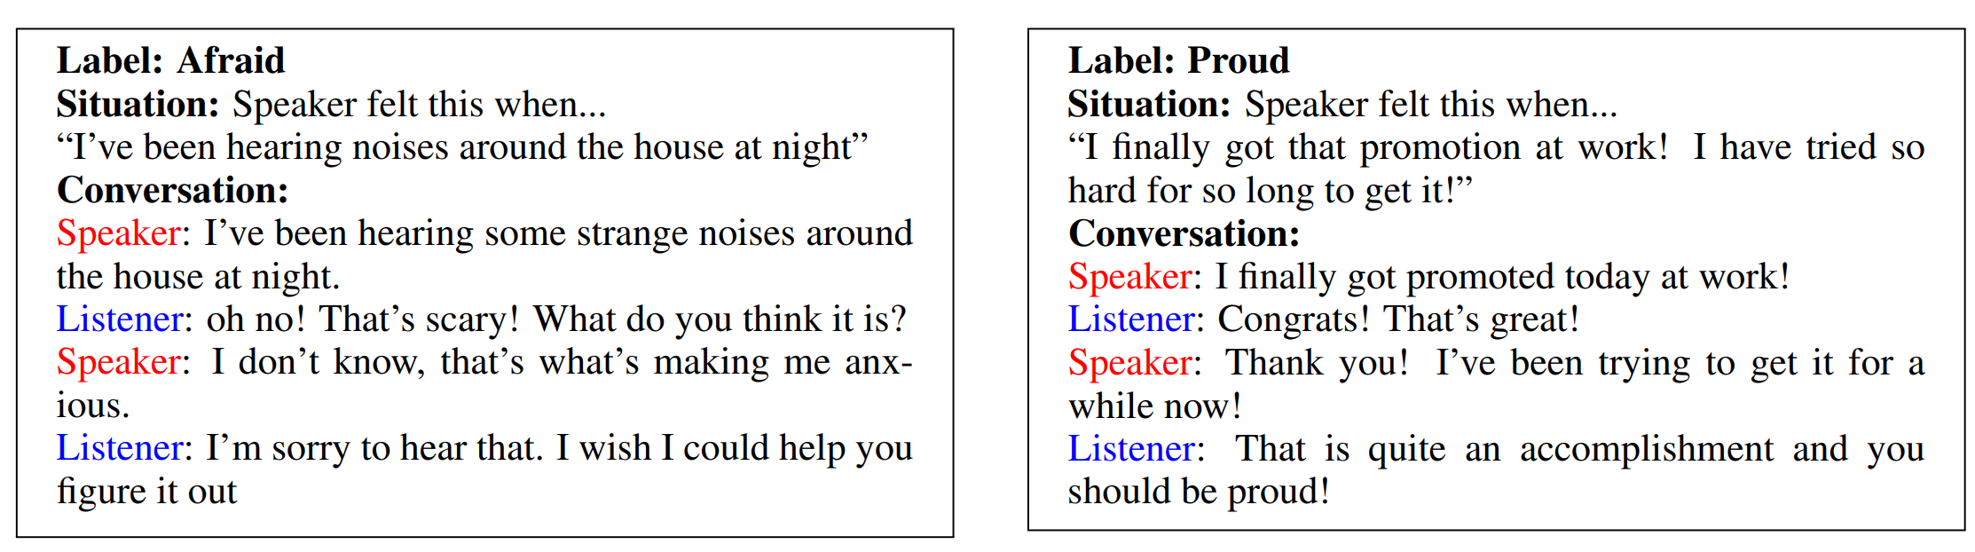
EMPATHETICDIALOGUES（Dataset）
2019 ACL Towards Empathetic Open-domain Conversation Models: a New Benchmark and Dataset

Slide 5
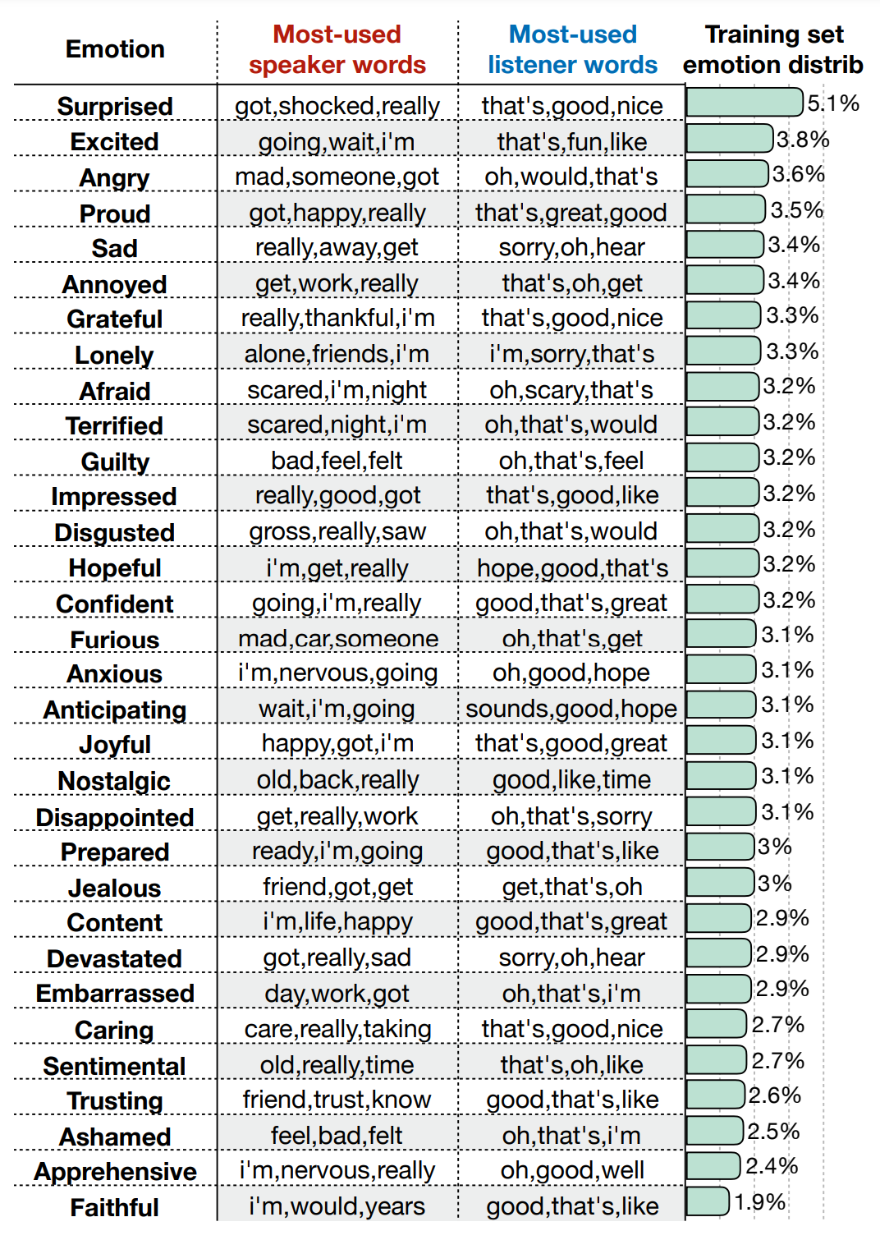
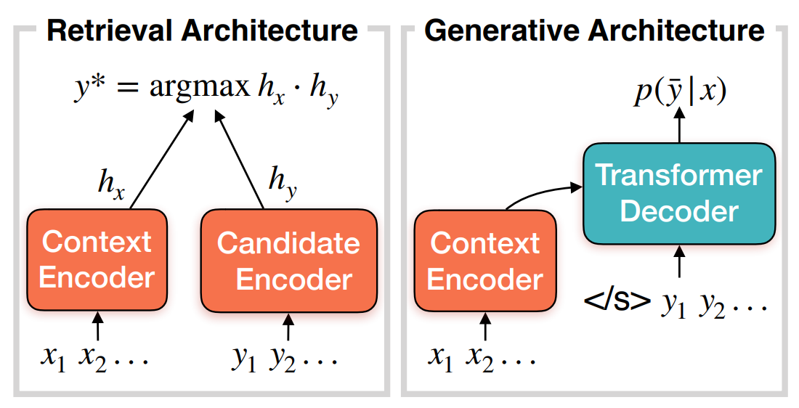
32 emotion labels
24k conversations
2019 ACL Towards Empathetic Open-domain Conversation Models: a New Benchmark and Dataset

Slide 6

Evaluation
Automatic Metrics
PPL (perplexity)
BLEU (n-grams overlap)
H@1,100 (accuracy)
Distinct (n-grams diversity)
Human ratings
Empathy
Relevance
Fluency
A/B Test
$$\exp^{ave_loss}{ }$$
win
lost
tie

Slide 7
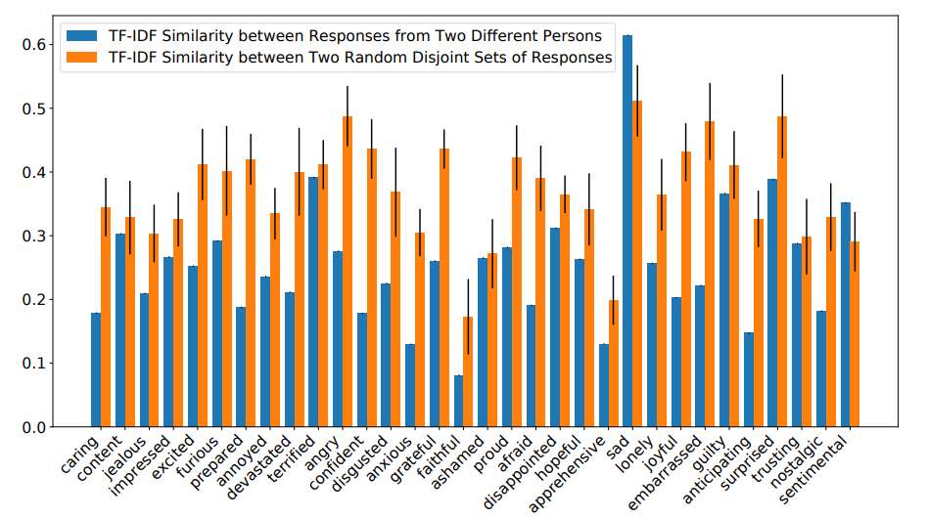
Persona Empathetic Conversation
Persona
influence
Empathy
2020 EMNLP Towards Persona-Based Empathetic Conversational Models

Slide 8
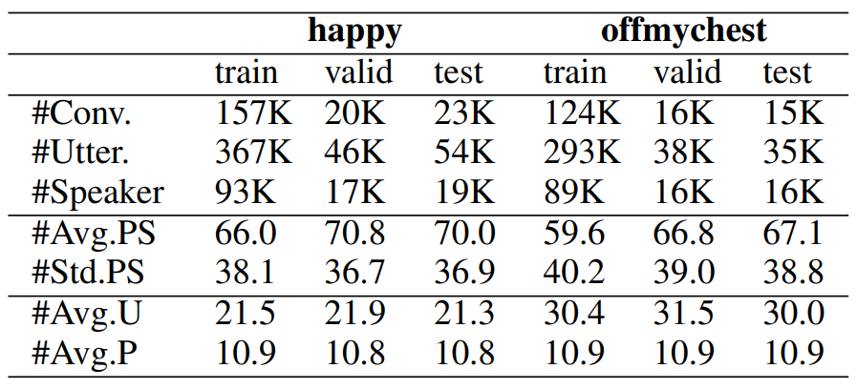
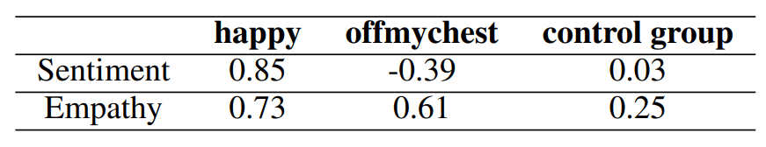
Data Source
Reddits, a discussion forum
Happy subreddit
warm and happy stories and thoughts
Offmychest subreddit
deeply emotional things
Casual conversation
casual conversations, i.e., the control group
Sentiment [-1, 1]
Empathy [0, 1]

Slide 9
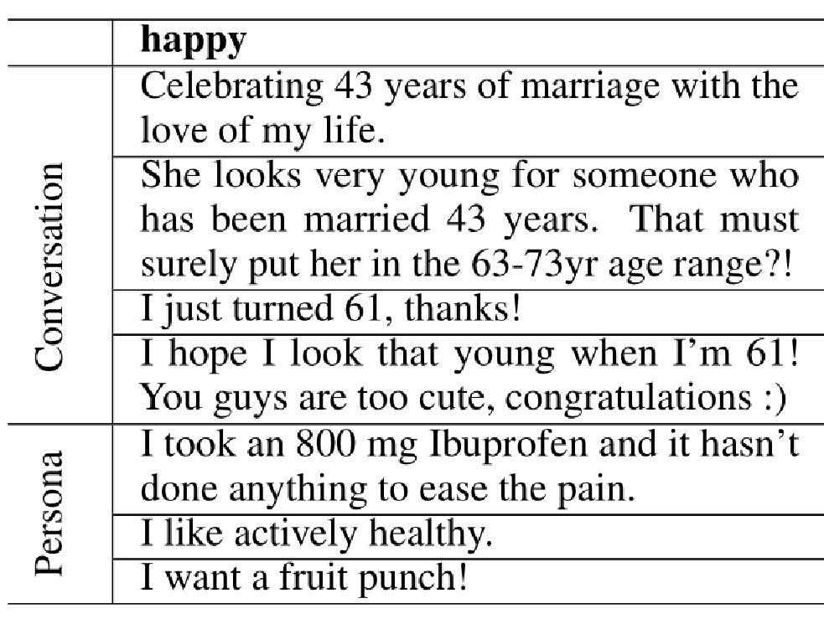
Conversation
All speakers have at least one persona sentence
The last speaker is different from the first speaker in each conversation
post
A: xxxxxxx
B: xxxxxxx
C: xxxxxxx
B: xxxxxxx
C: xxxxxxx
context
response

Slide 10
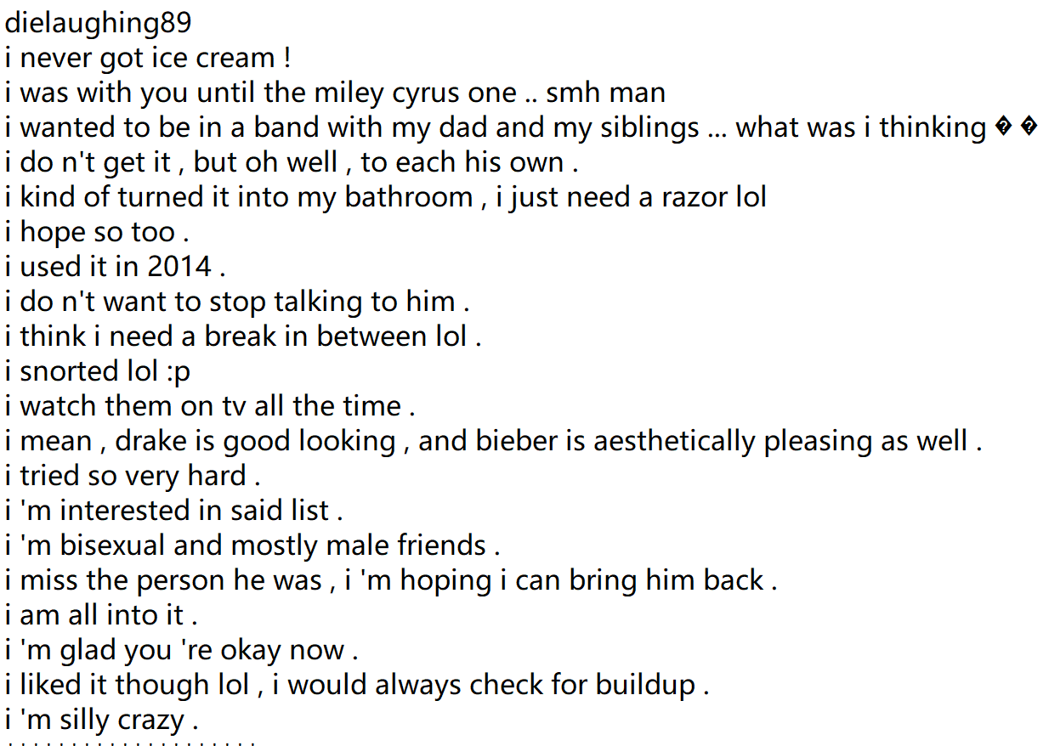
Persona Collection
Speaker name
Source：Posts / comments
1) between 4 and 20 words
2) the first word is “i”
3) at least one verb;
4) at least one noun or adjective
5) at least one content word
persona
Up to 100 persona sentences.

Slide 11
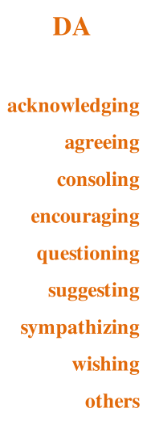

CoMAE
Emotional reaction (ER)
I feel really sad for you.
Communication Mechanisms (CM)
Interpretation (IP)
This must be terrifying, I also have similar situations.
Exploration (EX)
Are you still feeling alone now?
Dialog Act (DA)
Emotion (EM)
2021 ACL Findings CoMAE: A Multi-factor Hierarchical Framework for Empathetic Response Generation

Slide 12
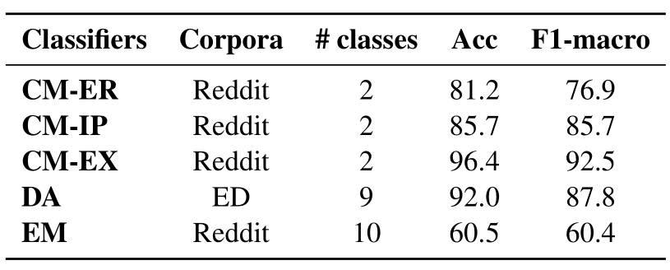
CoMAE
Emotional reaction (ER)
Communication Mechanisms (CM)
Interpretation (IP)
Exploration (EX)
Dialog Act (DA)
Emotion (EM)

Slide 13
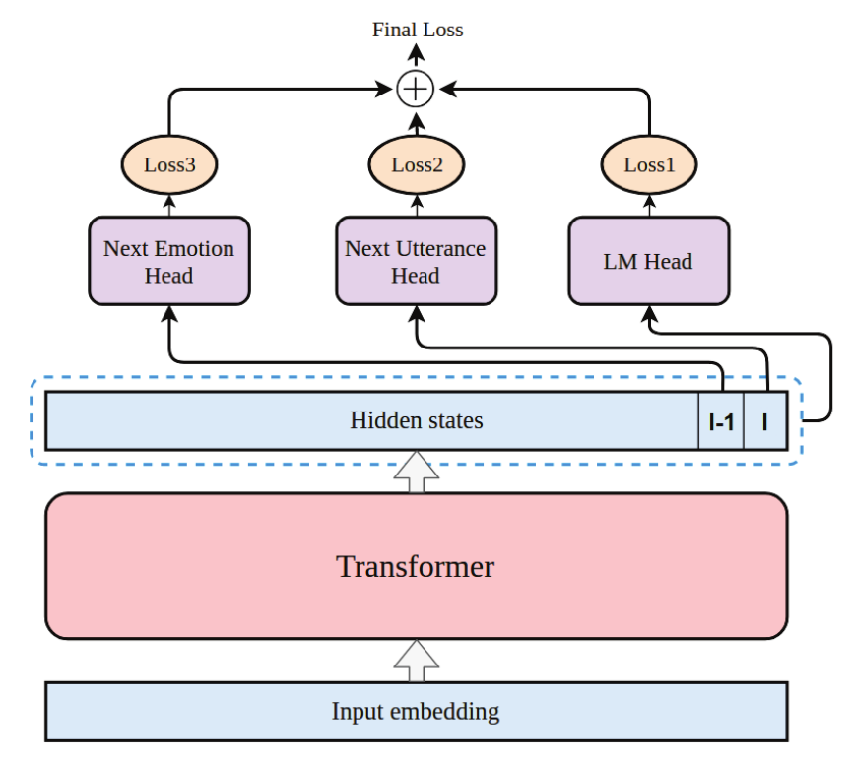
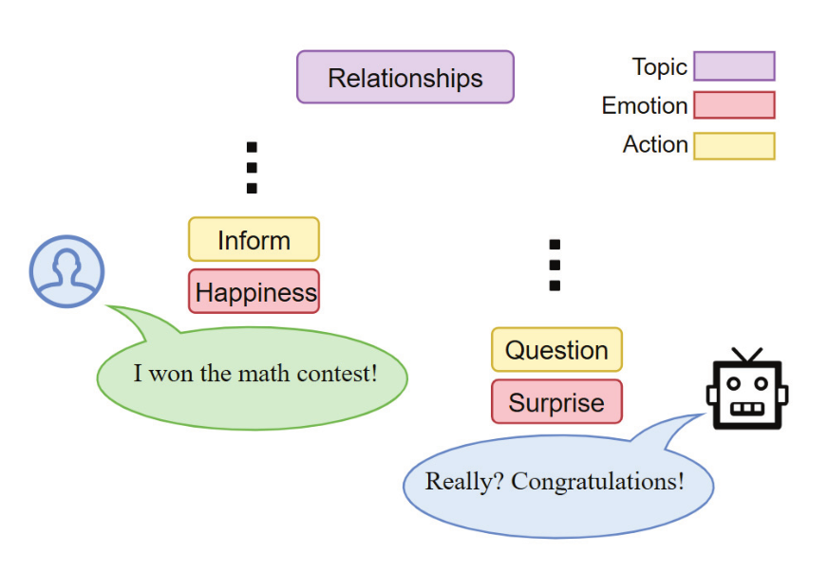
EmpTransfo
2020 AAAI EmpTransfo: A Multi-Head Transformer Architecture for Creating Empathetic Dialog System

Slide 14
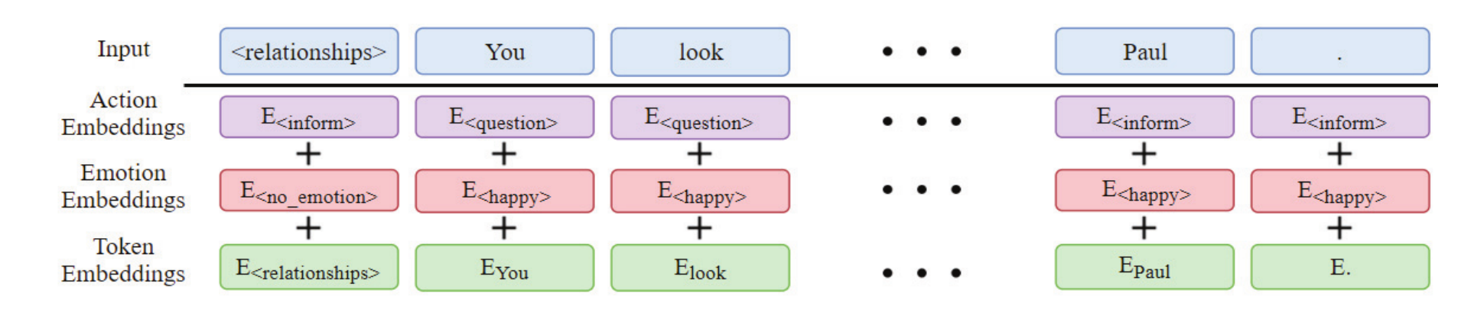
EmpTransfo

Slide 15
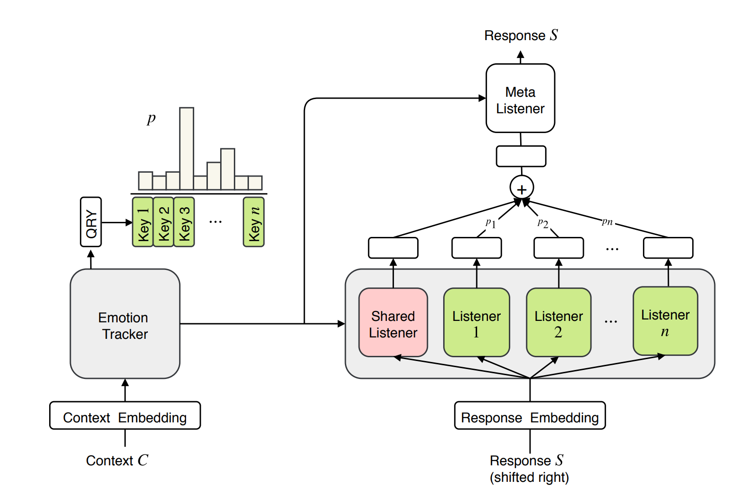
MoEL
2019 EMNLP MoEL: Mixture of Empathetic Listeners

Slide 16
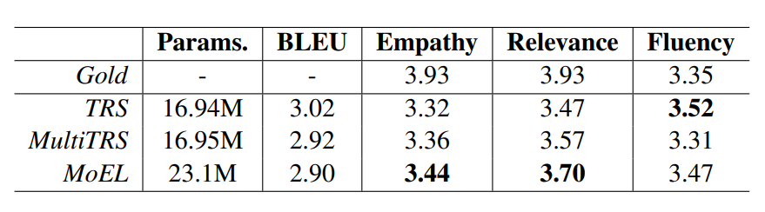
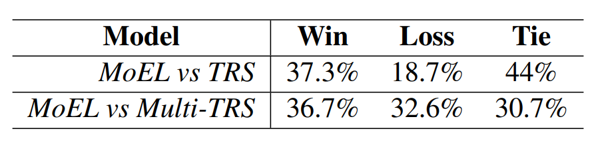
MoEL

Slide 17
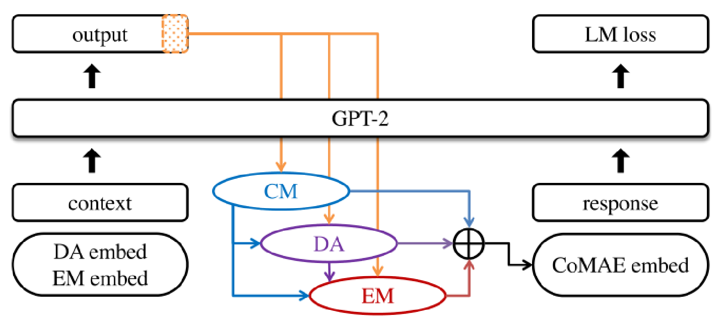
CoMAE
CM
DA
EM
Independency
2021 ACL Findings CoMAE: A Multi-factor Hierarchical Framework for Empathetic Response Generation

Slide 18
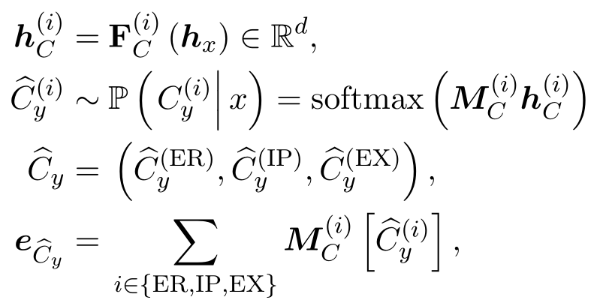
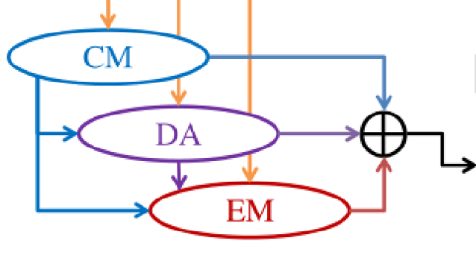

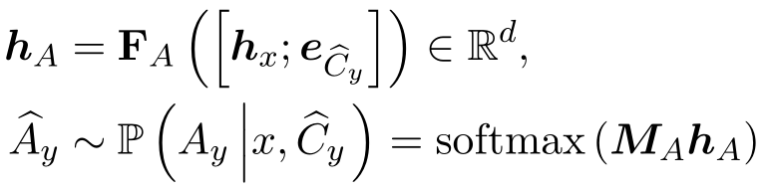
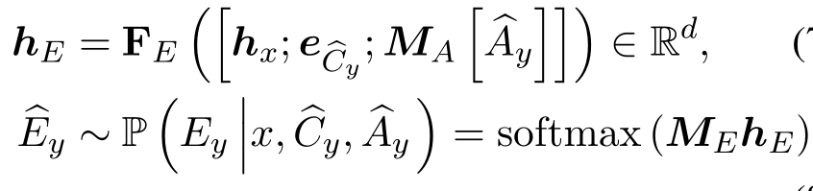

CoMAE
CM
Hierarchically modeling of these empathy factors
DA
CM→DA→EM
EM
2021 ACL Findings CoMAE: A Multi-factor Hierarchical Framework for Empathetic Response Generation

Slide 19
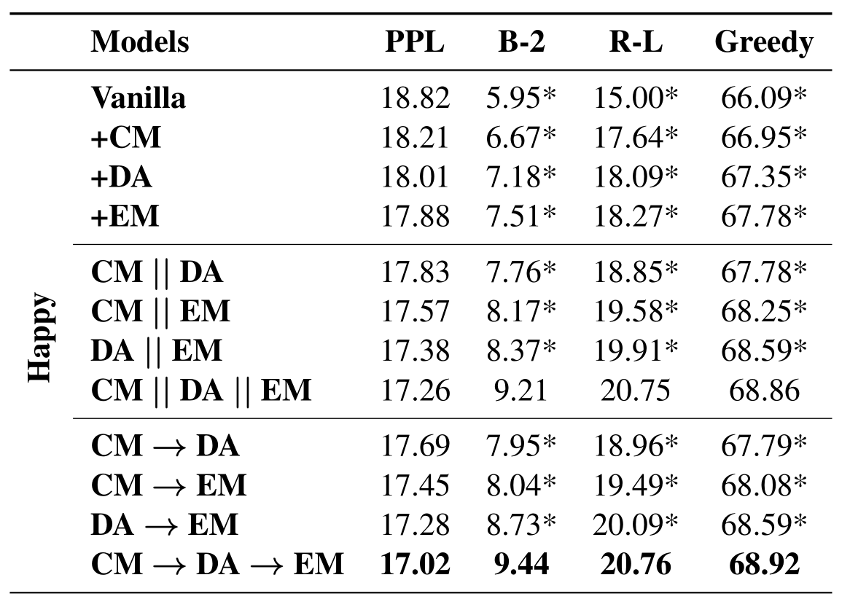
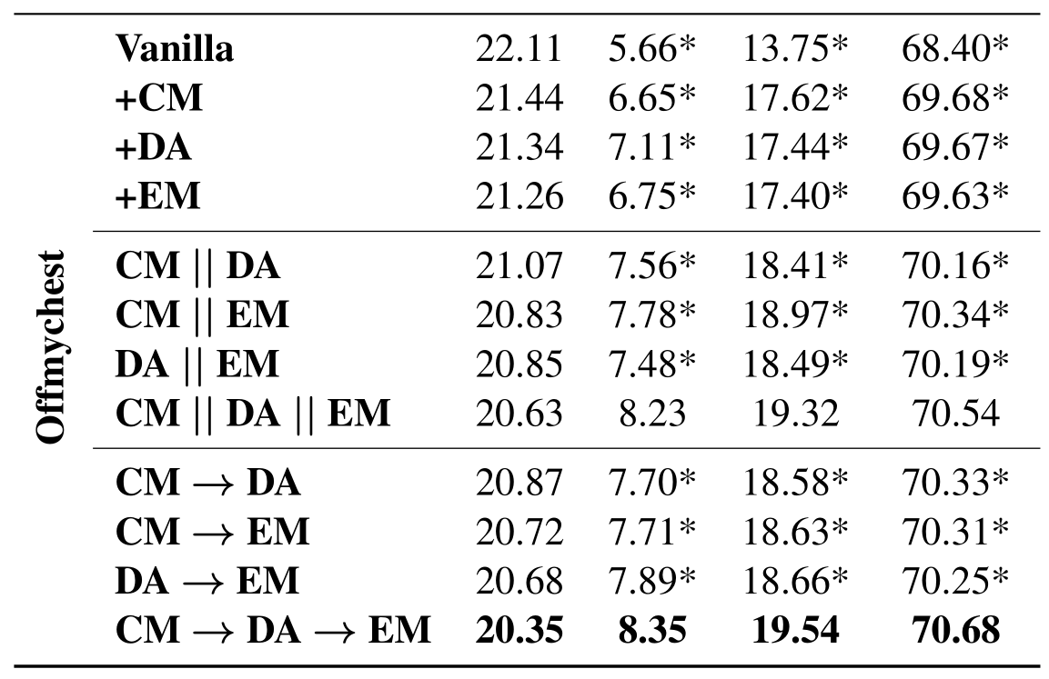
Results

Slide 20
MIME
User
Dialogue agent
Mimic user’s emotion to some degree
Positive emotion
Positive response
Negative emotion
Negativity mixed with some positivity
2020 EMNLP MIME: MIMicking Emotions for Empathetic Response Generation

Slide 21
MIME
Mimicry
Positivity
Positive
Non-Mimicry
Negativity
Mimicry
Negativity
Negative
Non-Mimicry
Positivity
2020 EMNLP MIME: MIMicking Emotions for Empathetic Response Generation

Slide 22
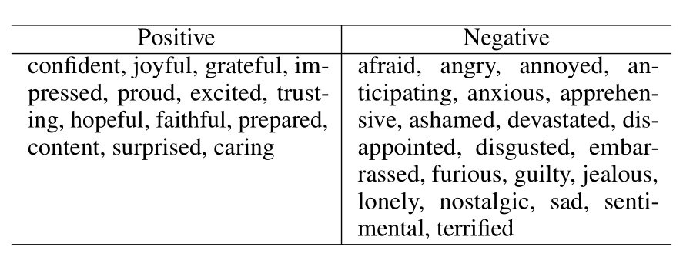
MIME
Emotion Grouping
13
19
2020 EMNLP MIME: MIMicking Emotions for Empathetic Response Generation

Slide 23
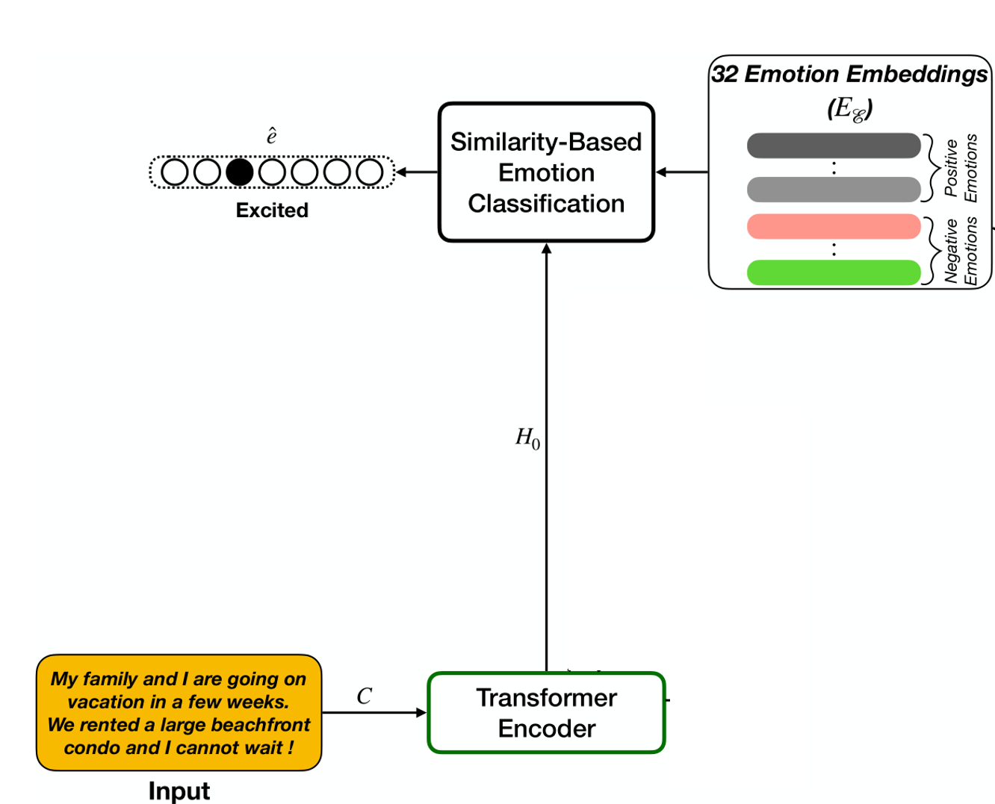
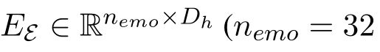
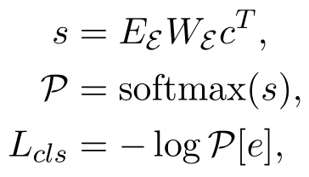
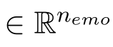
MIME
Emotion Embedding and Classification

Slide 24
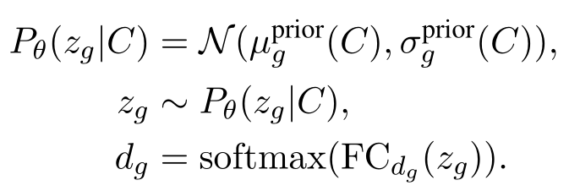
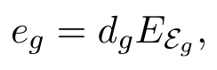


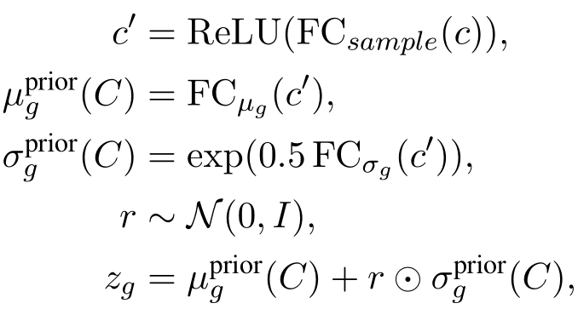
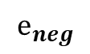
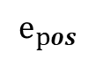
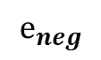
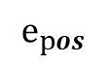
MIME (Response-Emotion Sampling)
$$e_{pos}$$
Context
$$e_{neg}$$
$$e_{pos}$$
$$e_{neg}$$
Positive
Negative
2020 EMNLP MIME: MIMicking Emotions for Empathetic Response Generation

Slide 25
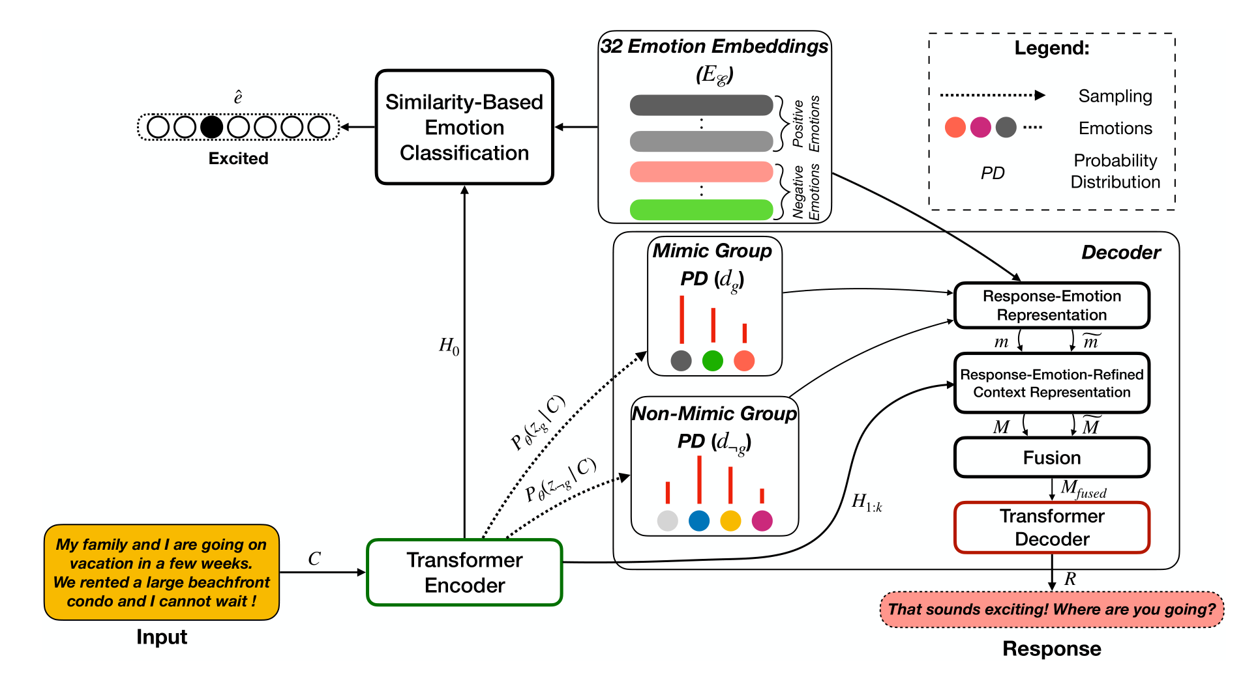
MIME

Slide 26
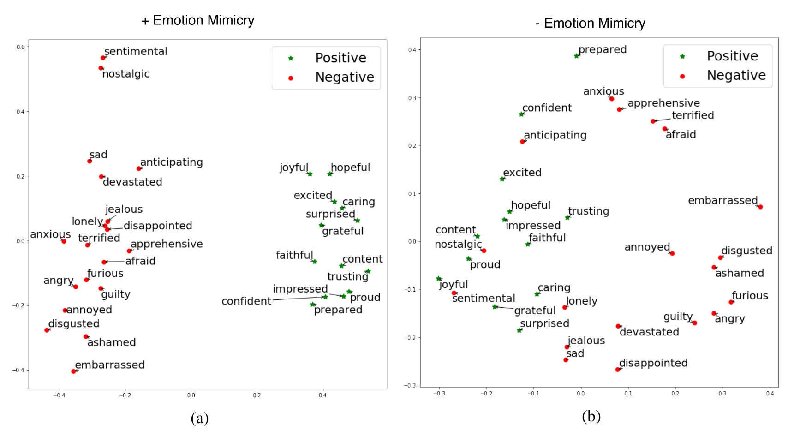
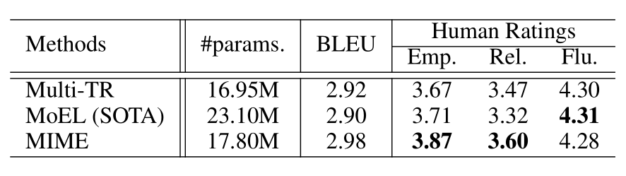
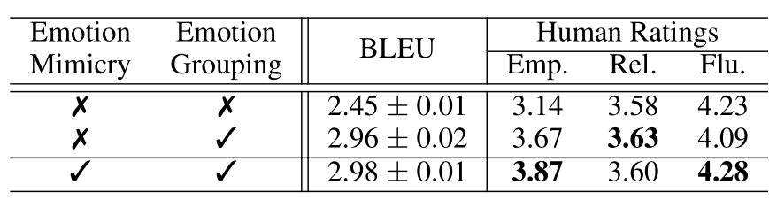
Results

Slide 27
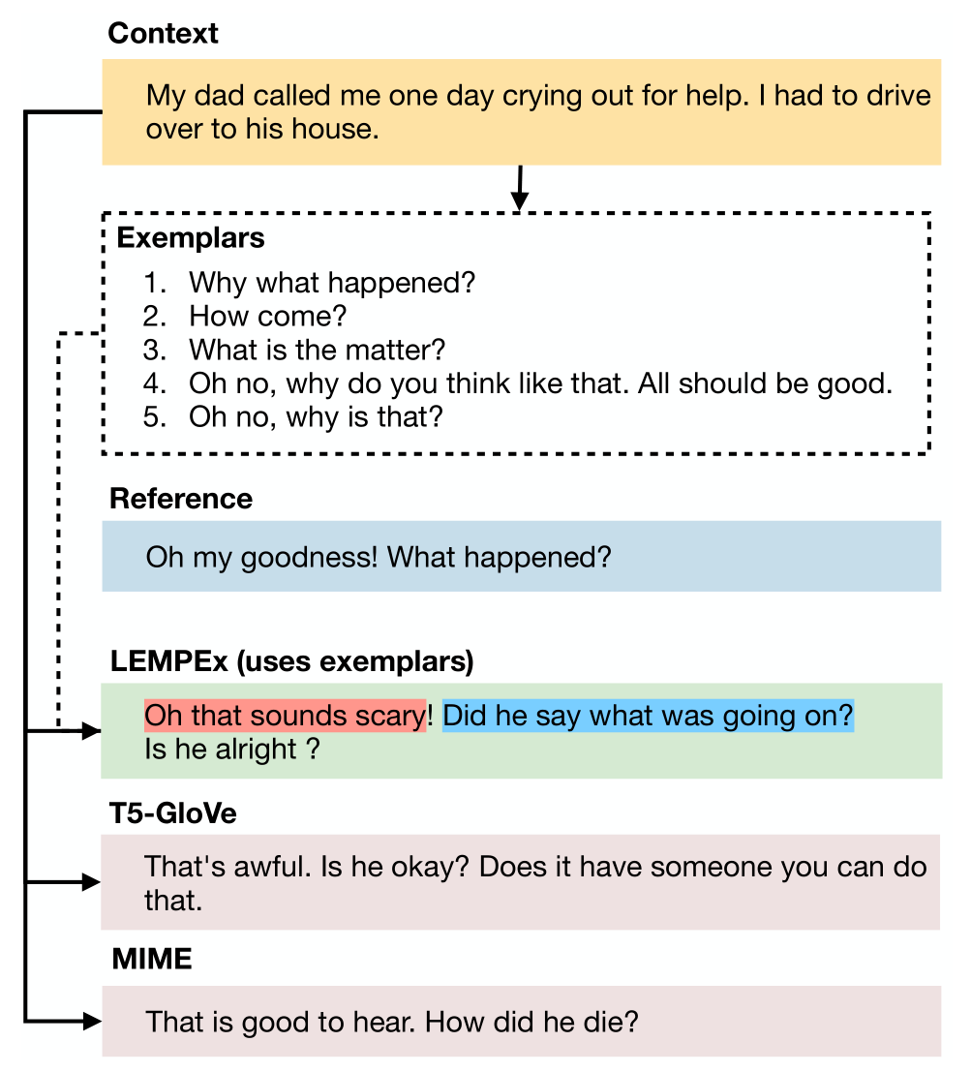
LEMPEx
Exemplars
Guide the generator with stylistic and thematic cues
2021 CIKM Exemplars-guided Empathetic Response Generation Controlled by the Elements of Human Communication

Slide 28
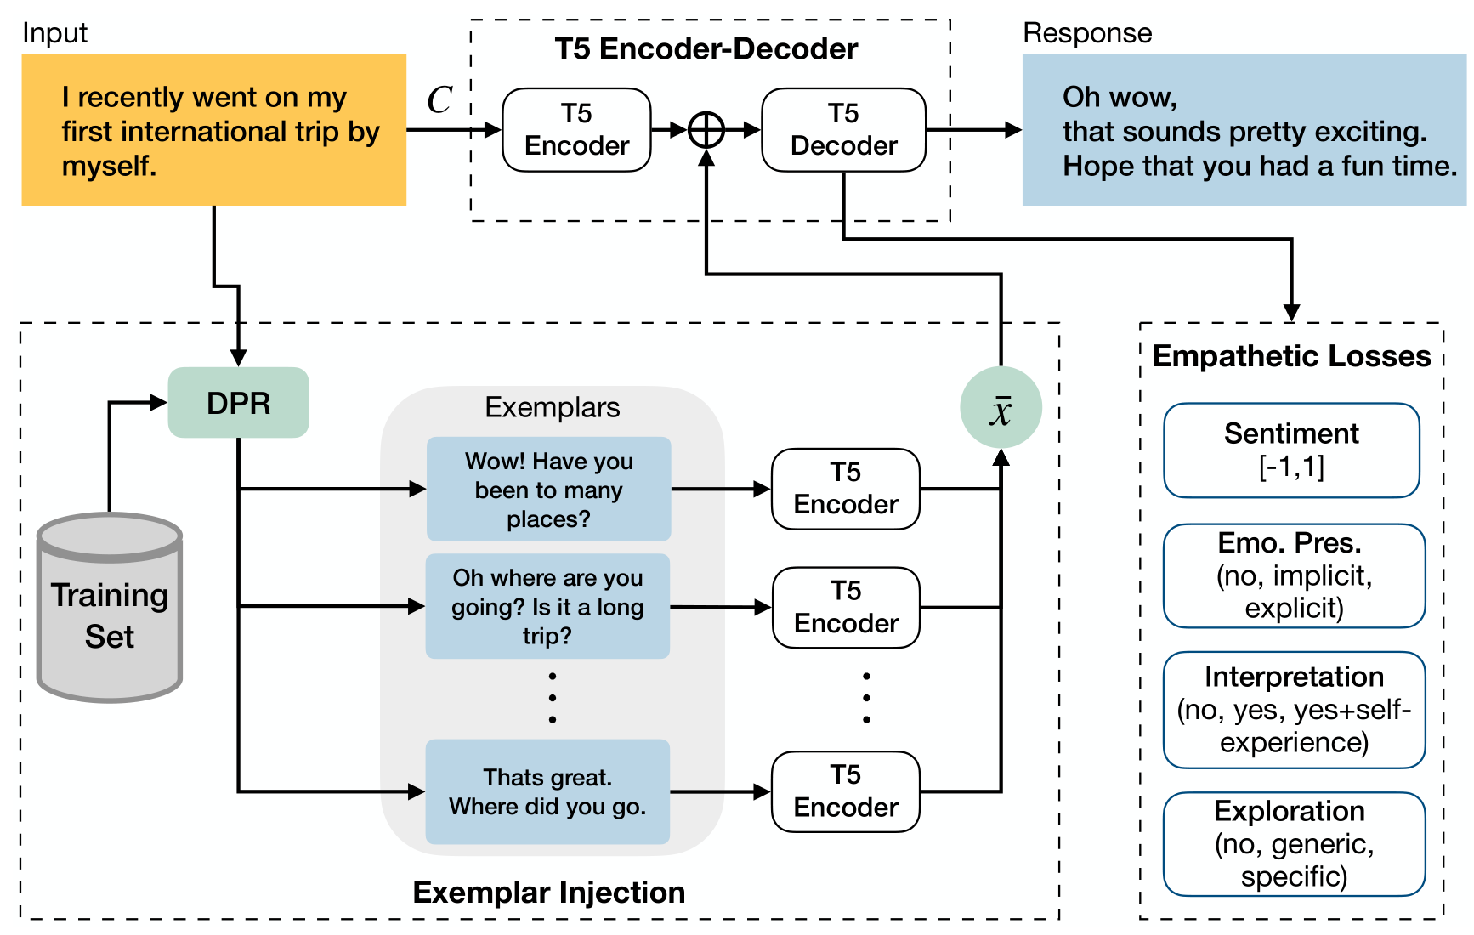
LEMPEx
sentiment
emotional presence
interpretation
exploration
2021 CIKM Exemplars-guided Empathetic Response Generation Controlled by the Elements of Human Communication

Slide 29
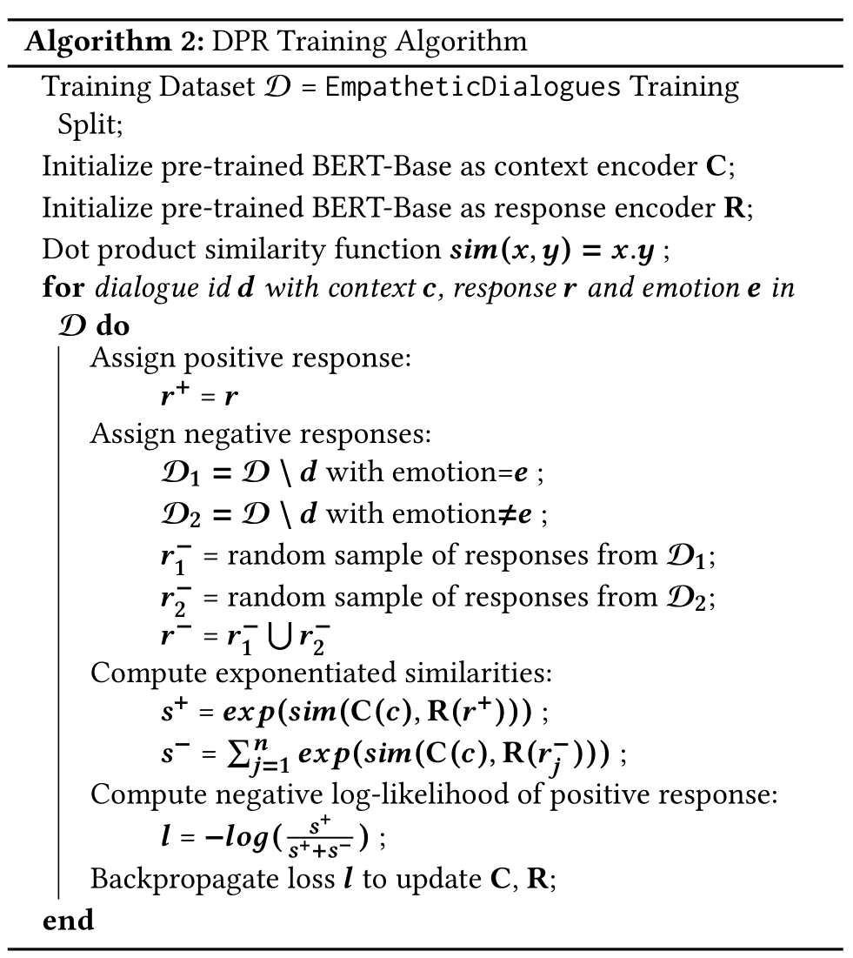
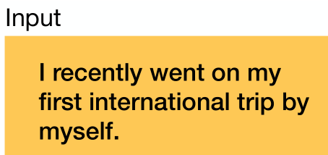
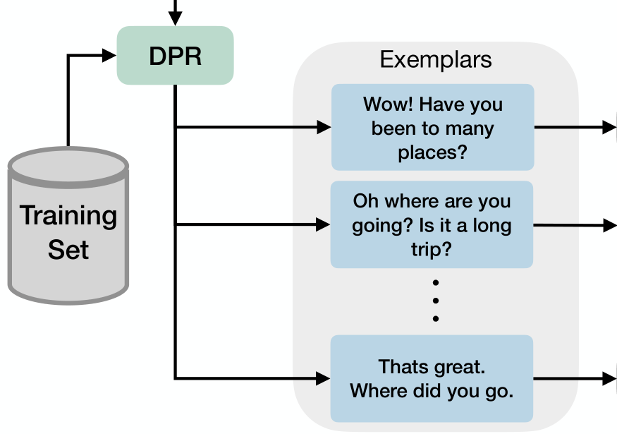
LEMPEx

Slide 30
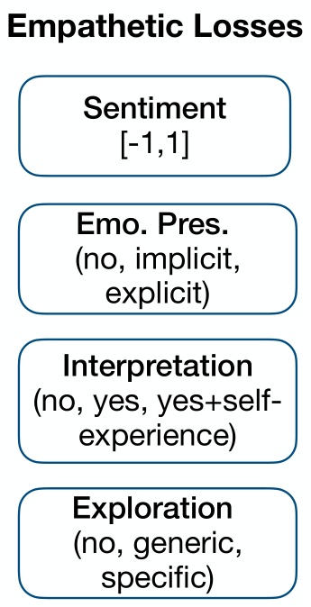
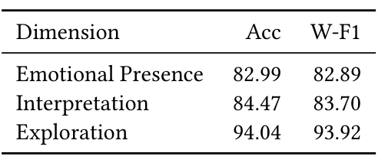
LEMPEx
VADER is used to generate a sentiment score
Train 3 classifiers using T5 on EmpathyMentalHealth dataset

Slide 31
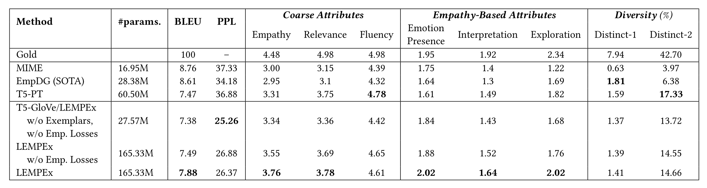
Results

Slide 32
ALL
2021.12.13

